Slide 1
Design Presentation: Power BI in Azure Synapse
Owner: Sean Norman
CSA07P | 1 of 2
Session Day/Time: |  | Presenters/SMEs:
Virtual Format and Software:
Cohort / Breakout Mgmt
Objective of Session: | As a result of attending this, attendees will better be able to…
Existing Sources: | <link to any supporting content sources (if any)>
Learner Content: | <Link to draft ppt slide deck and any other materials that the attendees would be seeing or using as part of this session>
Presenter/ SME Guide Content: | <Link to any supporting materials that are just for the presenter and/or supporting SMEs>
Required Homework + name of session for HW review: | No homework or pre-required content needed for this session

Slide 2
Design Presentation: Power BI in Azure Synapse
Owner: Sean Norman
CSA07P | 2 of 2
Session Flow and Detailed Agenda |  | Presenter/SME: | Time
Prework | No attendee pre-work needed for this session | N/A | N/A
Session Introduction | Set context for when this process takes place | <presenter> | 3 mins
Body of the session / discussion, activities, Q&A... |  | <presenter> | 25 mins
Session Closing / Homework |  | <presenter> | 2 mins

Slide 3
Topics Covered
Power BI in Azure Synapse
Data preparation and modeling
Security considerations
Performance optimization

Slide 4
Power BI in Azure Synapse

Slide 5

Agenda
1 Data preparation and modeling
Synapse Analytics and Power BI integration. Standardizing reporting data with Synapse Analytics
2 Security considerations
Choosing the right option: Row Level Security, Column Level Security, Dynamic Data Masking
3 Performance optimization
Improving Power BI performance with Synapse Analytics features

Slide 6
Data preparation and modeling

Slide 7





Synapse Analytics and Power BI integration
Synapse Analytics Workspace
Power BI Workspace
Synapse Studio
Power BI
Linked
Sevice
Reports
Reports
Datasets
Datasets
Manage
SQL
On-demand
SQL
Pool
Power BI
Desktop
Data Lake

Slide 8






Standardize reporting data with Synapse Analytics
Power BI
Synapse Analytics
SQL
Pool
Synapse Pipelines
Common Data Model
Primary Data Lake
Stage 1
Stage 2
Enrichment
Stage 3
Enrichment

Slide 9
Security considerations

Slide 10

Complete Data Security
Category | Feature
Data Protection | Data in Transit | 
 | Data Encryption at Rest | 
 | Data Discovery and Classification | 
Access Control | Object Level Security (Tables/Views) | 
 | Row Level Security | 
 | Column Level Security | 
 | Dynamic Data Masking | 
 | SQL Login | 
Authentication | Azure Active Directory | 
 | Multi-Factor Authentication | 
 | Virtual Networks | 
Network Security | Firewall | 
 | Azure ExpressRoute | 
 | Thread Detection | 
Threat Protection | Auditing | 
 | Vulnerability Assessment | 

Slide 11
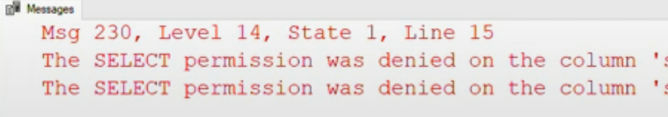
Using fine grained security in Power BI
Column
Level
Security
Dynamic
Data
Masking
CustomerID | FullName | Region | Income
CustomerID | FullName | Region | Income
 | xxxxx |  | xxxxx
 | xxxxx |  | xxxxx
 | xxxxx |  | xxxxx
 | xxxxx |  | xxxxx
 | xxxxx |  | xxxxx
 | xxxxx |  | xxxxx
 | xxxxx |  | xxxxx
 | xxxxx |  | xxxxx
Row
Level
Security
When an user with no access to FullName and Income columns, runs the query, it will
bounce an error back:
Equivalent approach with Dynamic Data Masking
Better suited for Power BI because it preserves schema needed to create the visualizations in the report.

Slide 12
Performance Optimization
Notes:
https://www.jamesserra.com/archive/2019/12/azure-synapse-analytics-power-bi/

Slide 13
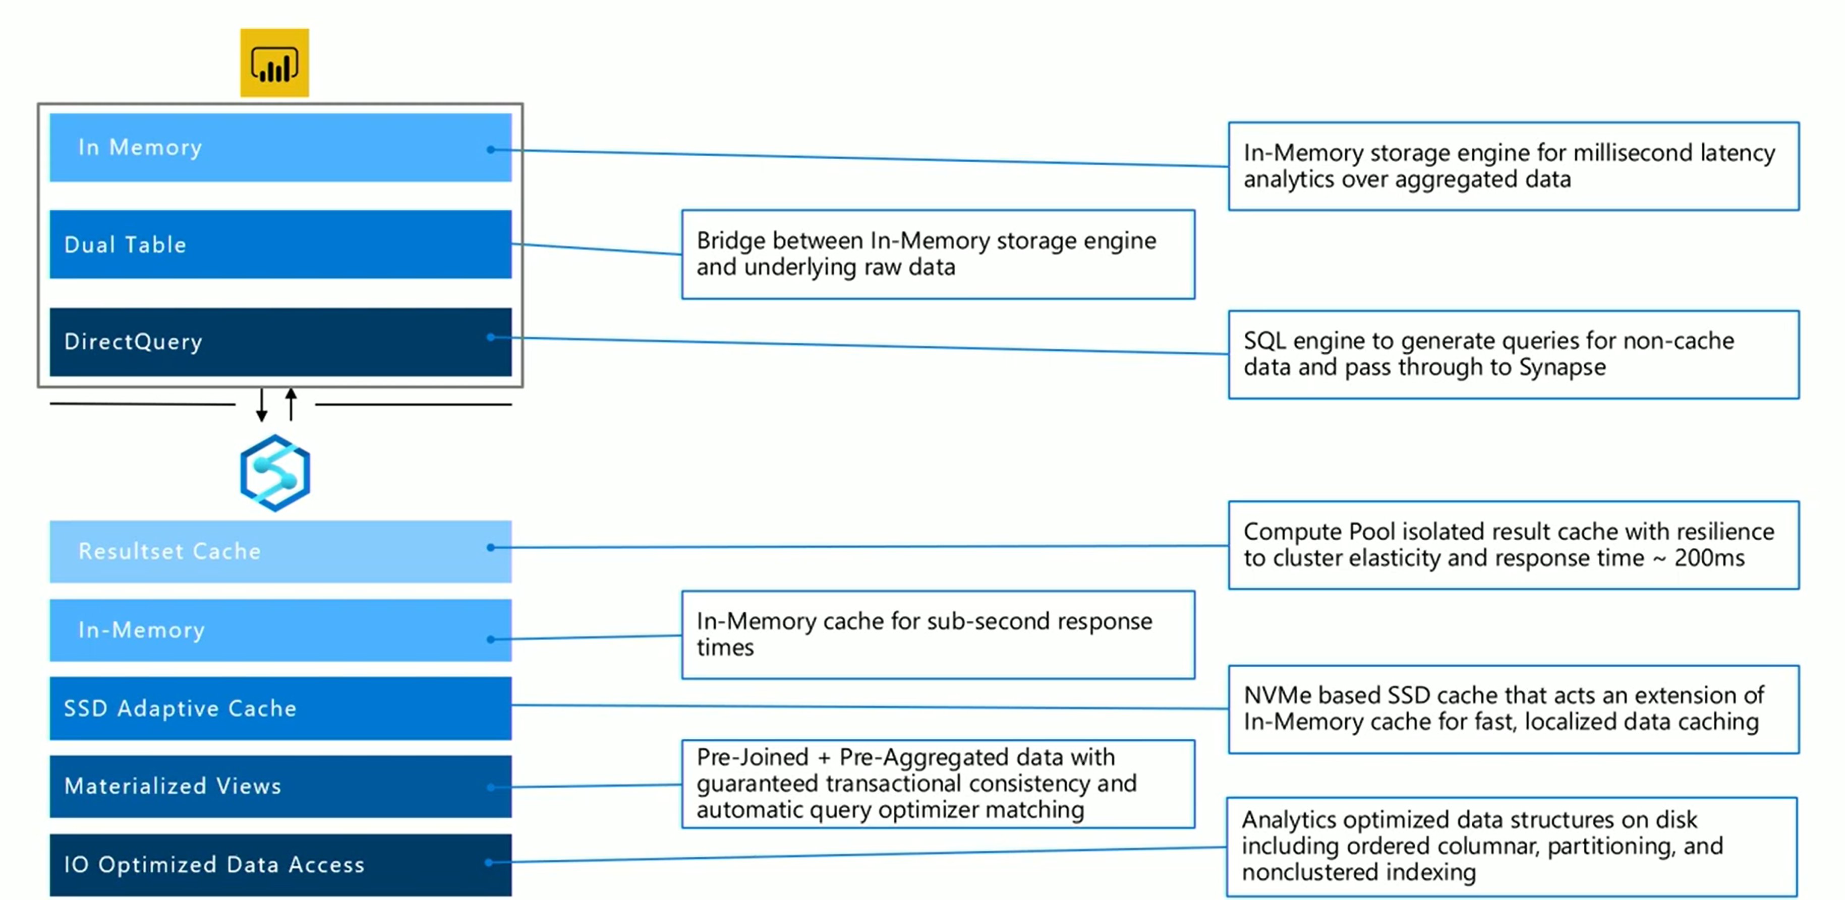
Performance optimization end-to-end
Notes:
Caching layers in PowerBI
- In-Memory (Import): data imported into memory, this technology unlocks sizable datasets for interactive analyses, fast queries expected for massive datasets; with large datasets, you will need a lot of memory
- DirectQuery: dataset acts as virtual pass through layer; as user interact with visualizations, Power BI generates SQL queries to Synapse SQL Pools
Dual Storage: in memory or direct query depending on which one is more efficient
The engine decides when to switch from in-memory to direct query and pushes the logic to the Synapse SQL Pool; depending on the context of the query tables can act as either cached (imported) or not cached
Composite Models: pick and choose which table to cache into memory; combine data from one or more DirectQuery sources, and/or combine data from a mix of DirectQuery sources and imported data
New performance features in Synapse
Result-set caching: caches query results in the user database for repetitive use.
improves query performance (down to milliseconds)
reduces compute resource usage.
queries using cached results set do not use any concurrency slots in Azure Synapse Analytics and thus do not count against existing concurrency limits
Materialized Views: views that pre-compute, store, and maintain data in SQL DW just like a table.
queries that use all or a subset of the data in materialized views can get faster performance.
queries can use a materialized view without making direct reference to it

Slide 14
DirectQuery
Import
Geography
Geography
Customer
Customer
Sales
Sales
Date
Date
Product
Product
Reseller Sales
Reseller Sales
Employee
Employee
Notes:
The DirectQuery approach generates SQL queries to Synapse SQL Pools
Vs
The In-Memory approach where all data is cached in memory

Slide 15
DirectQuery
&
Import
Geography
Geography
Customer
Customer
Sales
Sales
Date
Date
Product
Product
Reseller Sales
Reseller Sales
Employee
Employee
Notes:
Composite models: You can pick and choose which table to cache into memory

Slide 16
DirectQuery
&
Import
Geography
Geography
Customer
Customer
Sales Agg
Sales
Date
Date
Product
Product
Reseller Sales
Reseller Sales
Employee
Employee

Slide 17
Aggregations
Geography
Geography
Sales Agg
Customer
Customer
Sales
Date
Date
Product
Product
Reseller Sales
Reseller Sales
Employee
Employee
Notes:
Aggregations: Create the aggregation table SalesAgg (the non empty cross join of DateID and GeographyID) – it will be cheap to cache (eg. Sales 26 billion rows -> SalesAgg 2 million rows)

Slide 18
Aggregations
SummarizeColumns(
Date[Year],
Geography[City],
"Sales", Sum(Sales[Amount])
)
Geography
Geography
Sales Agg
Customer
Customer
Sales
Date
Date
Product
Hits in-memory cache
Product
Reseller Sales
Reseller Sales
Employee
Employee
Notes:
Configure the engine: Any DAX query asking for Sum(Sales[Amount]) by City – the engine figures out that it can answer from the in memory cache, from the SalesAgg table which is super fast.
The user knows nothing about the aggregation table.

Slide 19
Aggregations
SummarizeColumns(
Date[Year],
Customer[Name],
"Sales", Sum(Sales[Amount])
)
Geography
Geography
Sales Agg
Customer
Customer
Sales
Date
DirectQuery
Date
Product
Product
SELECT [Year],
[Name],
SUM([Amount]) AS [Amount]
FROM [Sales]
INNER JOIN [Date] ON ...
INNER JOIN [Customer] ON ...
GROUP BY [Year],
[Name]
Reseller Sales
Reseller Sales
Employee
Employee
Notes:
If the user asks for Sum(Sales[Amount]) by Customer Name – it touches the Customer table, which is not at the granularity that can hit the in-memory cache -> it will on the fly convert to DirectQuery. The Date table is a Dual Table so it pushes back some groupby down to the source, which is more efficient.

Slide 20






Performance Optimized Storage
Elastic Architecture
Columnar Storage
Columnar Ordering
Table Partitioning
Nonclustered Indexes
Hash Distribution
Materialized Views
Resultset Cache

Slide 21

Power BI
Scaling to Petabytes Power BI DirectQuery Composite Models Aggregation Tables
SQL Query
Tables
Optimizer
Decision
Data Warehouse
Materialized Views

Slide 22



SELECT
ProductName
ProductKey,
SUM(Amount) AS TotalSales
FROM
Fact Sales
INNER JOIN DimProduct
GROUP BY
ProductName,
ProductKey
Scaling to Petabytes Result set Cache Automatic query matching Implicit creating from query activity Resilient to cluster elasticity
Execution 2
Cache Hit
Resultset
Cache
~.2 seconds
Execution 1
Cache Miss
Regular Execution
Data
Warehouse
Notes:
Automatically caches query results in the user database for repetitive use. This allows subsequent query executions to get results directly from the persisted cache so recomputation is not needed. Result set caching improves query performance (down to milliseconds) and reduces compute resource usage. In addition, queries using cached results set do not use any concurrency slots in Azure Synapse Analytics and thus do not count against existing concurrency limits

Slide 23
CREATE MATERIALZIED VIEW vw_ProductSales
WITH (DISTRIBUTION = HASH(ProductKey))
AS
SELECT
ProductName
ProductKey,
SUM(Amount) AS TotalSales
FROM
FactSales fs
INNER JOIN DimProduct dp ON fs.prodkey = dp.prodkey
GROUP BY
ProductName,
ProductKey
Scaling to Petabytes Materialized Views
Transactional consistently to data modification Automatic Query Optimizer matching
Notes:
Materialized view = A view that pre-computes, stores, and maintains its data in SQL DW just like a table. There’s no recomputation needed each time when a materialized view is used. Queries that use all or a subset of the data in materialized views can get faster performance. Even better, queries can use a materialized view without making direct reference to it, so there’s no need to change application code

Slide 24
CREATE MATERIALZIED VIEW mvw_ProductSales
WITH (DISTRIBUTION = HASH(ProductKey))
AS
SELECT
ProductName
ProductKey,
SUM(Amount) AS TotalSales
FROM
FactSales fs
INNER JOIN DimProduct dp
ON fs.prodkey = dp.prodkey
GROUP BY
ProductName,
ProductKey
FactSales Table
10B Records
DimProduct Table
1,000 Records
Materialized View (1000 Records)
ProductName | ProductKey | TotalSales
Product A | 5453 | 784,943.00
Product B | 763 | 48,723.00
… | … | …
Scaling to Petabytes Materialized Views
Transactional consistently to data modification Automatic Query Optimizer matching
SELECT
<COLUMNS>
FROM FactSales fs
INNER JOIN
(
SELECT
ProductName
ProductKey,
SUM(Amount) AS TotalSales
FROM
FactSales fs
INNER JOIN DimProduct dp
GROUP BY
ProductName,
ProductKey ) ps
INNER JOIN FactInventory
GROUP BY …
FactInventory Table
mvw_ProductSales
1,000 Records

Slide 25
Scaling to Petabytes Materialized Views Transactional consistently to data modification Automatic Query Optimizer matching

Slide 26
Scaling to Petabytes Secondary Indexes Alternate path to seek records Fine grained storage for fast response
SELECT CustomerKey, SUM(Amount) FROM <table>
WHERE CustomerKey = 489233
Secondary index CustomerKey
CustomerKey
ProductKey
Amount
Minimum >
120934
1
1
#
5000
#
10000
#
Maximum >
567823
2102
15000
#
20000
#
25000
#
567823
2102
30000
#
35000
#
984531
5423
40000
#
45000
#
50000
#
293402
5427
55000
#
60000
#
65000
#
569462
7230
70000
#
75000
#
44523
7320
80000
#
85000
#
90000
#
203431
9435
95000
#

Slide 27
Additional performance considerations
DWU units
Resource classes, workload management
Synapse SQL Pool vs. Azure Analysis Services
Notes:
TB detailed

Slide 28
Thank You slide
Thank you

